Slide 1
Cost function
Neural Networks: Learning
Machine Learning

Slide 2







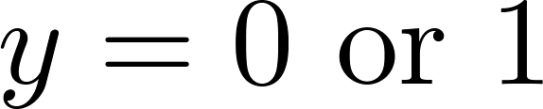
Neural Network (Classification)
total no. of layers in network
no. of units (not counting bias unit) in layer
Layer 1
Layer 2
Layer 3
Layer 4
Binary classification
1 output unit
Multi-class classification (K classes)
K output units
E.g. , , ,
pedestrian car motorcycle truck

Slide 3
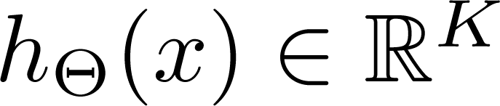
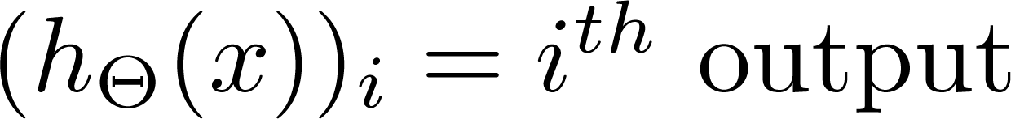
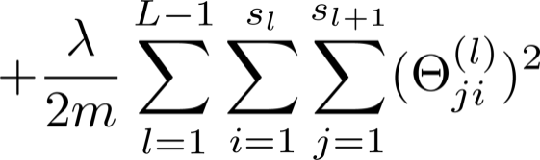
Cost function
Logistic regression:
Neural network:

Slide 4
Backpropagation algorithm
Neural Networks: Learning
Machine Learning

Slide 5
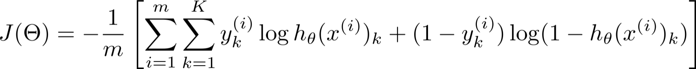
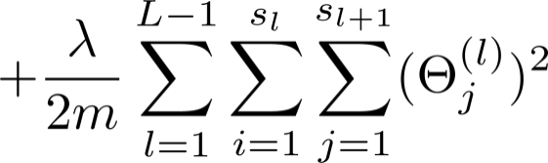
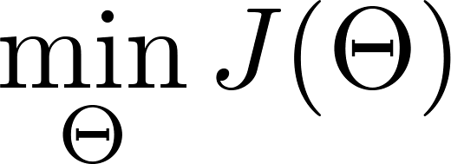

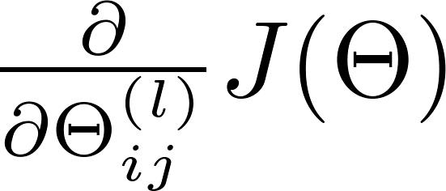
Gradient computation
Need code to compute:

Slide 6


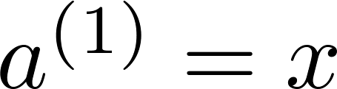
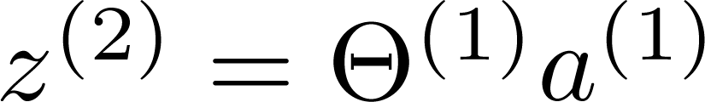
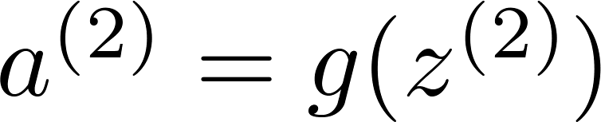
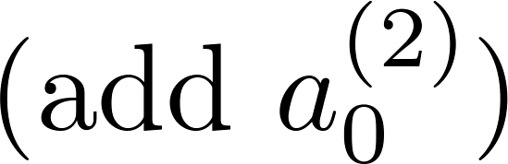
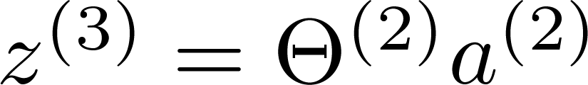
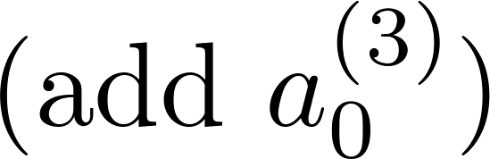
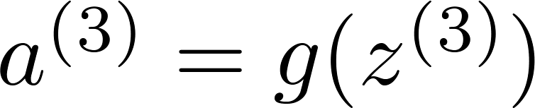
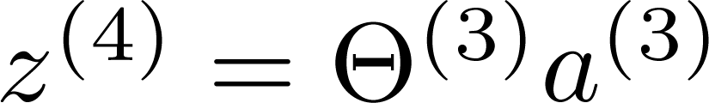
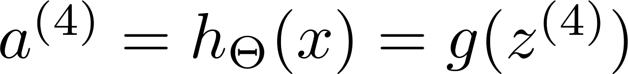

Gradient computation
Given one training example ( , ):
Forward propagation:
$$a^{(1)}$$
Layer 1
Layer 2
Layer 3
Layer 4

Slide 7
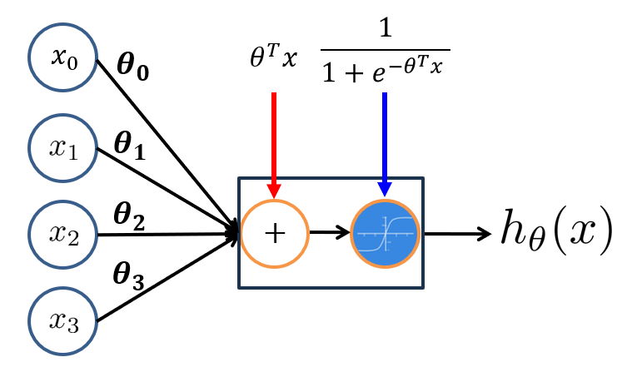
Gradient computation
Given one training example ( , ):
Forward propagation:
$$a^{(1)}$$
Layer 1
Layer 2
Layer 3
Layer 4

Slide 8
Gradient computation
Given one training example ( , ):
Forward propagation:
$$a^{(1)}$$
Layer 1
Layer 2
Layer 3
Layer 4

Slide 9

Gradient computation
Given one training example ( , ):
Forward propagation:
$$a^{(2)}$$
$$a^{(1)}$$
Bias term
Layer 1
Layer 2
Layer 3
Layer 4

Slide 10


Gradient computation
Given one training example ( , ):
Forward propagation:
$$a^{(3)}$$
$$a^{(4)}$$
$$a^{(2)}$$
$$a^{(1)}$$
Layer 1
Layer 2
Layer 3
Layer 4

Slide 11
Gradient computation
Given one training example ( , ):
Forward propagation:
$$a^{(3)}$$
$$a^{(4)}$$
$$a^{(2)}$$
$$a^{(1)}$$
Layer 2
Layer 1
Layer 2
Layer 3
Layer 4
Layer 3
Layer 4

Slide 12
Gradient computation
Given one training example ( , ):
Forward propagation:
$$a^{(3)}$$
$$a^{(4)}$$
$$a^{(2)}$$
$$a^{(1)}$$
Layer 2
Layer 1
Layer 2
Layer 3
Layer 4
Layer 3
Layer 4
Output / Prediction / Predicted Label

Slide 13








Gradient computation
$$a^{(2)}$$
$$a^{(3)}$$
$$a^{(4)}$$
$$a^{(1)}$$
Given one training example ( , ):
Forward propagation:
Layer 2
Layer 1
Layer 2
Layer 3
Layer 4
Layer 3
$$a_{1}^{(4)}$$
$$a_{2}^{(4)}$$
Layer 4
$$a_{3}^{(4)}$$
$$a_{4}^{(4)}$$

Slide 14




Gradient computation
$$a^{(2)}$$
$$a^{(3)}$$
$$a^{(4)}$$
$$a^{(1)}$$
Given one training example ( , ):
Forward propagation:
Layer 2
Layer 1
Layer 2
Layer 3
Layer 4
Layer 3
$$a_{1}^{(4)}$$
$$y_{1}$$
$$a_{2}^{(4)}$$
$$y_{2}$$
Layer 4
$$a_{3}^{(4)}$$
$$y_{3}$$
$$a_{4}^{(4)}$$
$$y_{4}$$

Slide 15
Gradient computation
$$a^{(2)}$$
$$a^{(3)}$$
$$a^{(4)}$$
$$a^{(1)}$$
Given one training example ( , ):
Forward propagation:
Layer 2
Layer 1
Layer 2
Layer 3
Layer 4
Prediction
Actual
Layer 3
$$a_{1}^{(4)}$$
$$y_{1}$$
$$a_{2}^{(4)}$$
$$y_{2}$$
Layer 4
$$a_{3}^{(4)}$$
$$y_{3}$$
$$a_{4}^{(4)}$$
$$y_{4}$$

Slide 16








Difference
There will be a difference between the actual and predicted labels
Due to the weights (Theta’s) that are randomly initialized
So we have to use this difference and “back-propagate” to update the values of (Theta’s)
Similar to Gradient Descent, Remember!!!
Prediction
Actual
$$a_{1}^{(4)}$$
$$y_{1}$$
$$a_{2}^{(4)}$$
$$y_{2}$$
$$a_{3}^{(4)}$$
$$y_{3}$$
$$a_{4}^{(4)}$$
$$y_{4}$$

Slide 17
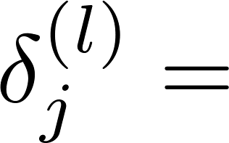
Gradient computation: Backpropagation algorithm
Layer 1
Layer 2
Layer 3
Layer 4

Slide 18

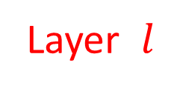
Gradient computation: Backpropagation algorithm
Layer $l$
Layer 1
Layer 2
Layer 3
Layer 4
Node $j$

Slide 19

Gradient computation: Backpropagation algorithm
Intuition: “error” of node in layer .
Layer 1
Layer 2
Layer 3
Layer 4

Slide 20
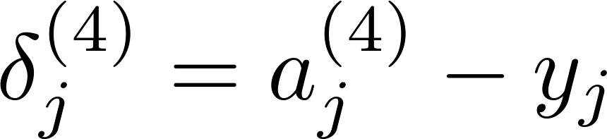









Gradient computation: Backpropagation algorithm
Intuition: “error” of node in layer .
$$δ^{(4)}$$
For each output unit (layer L = 4)
Prediction
Layer 1
Layer 2
Layer 3
Layer 4
Actual
$$a_{1}^{(4)}$$
$$y_{1}$$
$$a_{2}^{(4)}$$
$$y_{2}$$
$$a_{3}^{(4)}$$
$$y_{3}$$
$$a_{4}^{(4)}$$
$$y_{4}$$

Slide 21
Gradient computation: Backpropagation algorithm
Intuition: “error” of node in layer .
$$δ^{(4)}$$
For each output unit (layer L = 4)
Layer 1
Layer 2
Layer 3
Layer 4

Slide 22
Gradient computation: Backpropagation algorithm
Intuition: “error” of node in layer .
$$δ^{(4)}$$
For each output unit (layer L = 4)
Layer 1
Layer 2
Layer 3
Layer 4

Slide 23

Gradient computation: Backpropagation algorithm
Intuition: “error” of node in layer .
$$δ^{(4)}$$
For each output unit (layer L = 4)
Layer 1
Layer 2
Layer 3
Layer 4
$$a^{(3)}.∗(1−a^{\left(3\right)})$$

Slide 24

Gradient computation: Backpropagation algorithm
Intuition: “error” of node in layer .
$$δ^{(3)}$$
$$δ^{(4)}$$
For each output unit (layer L = 4)
Layer 1
Layer 2
Layer 3
Layer 4
$$a^{(3)}.∗(1−a^{\left(3\right)})$$

Slide 25

Gradient computation: Backpropagation algorithm
Intuition: “error” of node in layer .
$$δ^{(3)}$$
$$δ^{(4)}$$
For each output unit (layer L = 4)
Layer 1
Layer 2
Layer 3
Layer 4
$$a^{(2)}.∗(1−a^{\left(2\right)})$$

Slide 26

Gradient computation: Backpropagation algorithm
Intuition: “error” of node in layer .
$$δ^{(2)}$$
$$δ^{(3)}$$
$$δ^{(4)}$$
For each output unit (layer L = 4)
Layer 1
Layer 2
Layer 3
Layer 4
$$a^{(2)}.∗(1−a^{\left(2\right)})$$

Slide 27
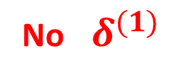
Gradient computation: Backpropagation algorithm
Intuition: “error” of node in layer .
$$δ^{(2)}$$
$$δ^{(3)}$$
$$δ^{(4)}$$
For each output unit (layer L = 4)
Layer 1
Layer 2
Layer 3
Layer 4
$$a^{(2)}.∗(1−a^{\left(2\right)})$$
No ${ δ}^{(1)}$

Slide 28
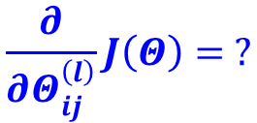
Gradient computation: Backpropagation algorithm
Intuition: “error” of node in layer .
$$δ^{(2)}$$
$$δ^{(3)}$$
$$δ^{(4)}$$
For each output unit (layer L = 4)
Layer 1
Layer 2
Layer 3
Layer 4
$$\frac{∂}{∂Θ_{ij}^{\left(l\right)}}J\left(Θ\right)= ?$$
Gradient Term, Remember!!!

Slide 29

Gradient computation: Backpropagation algorithm
Intuition: “error” of node in layer .
For each output unit (layer L = 4)
Layer 1
Layer 2
Layer 3
Layer 4
$$\frac{∂}{∂Θ^{(l)}}J\left(Θ\right)= δ^{(l+1)}{[a^{(l)}]}^{T}$$

Slide 30


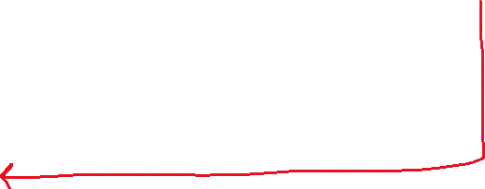


Gradient computation: Backpropagation algorithm
Intuition: “error” of node in layer .
For each output unit (layer L = 4)
Layer 1
Layer 2
Layer 3
Layer 4
$$\frac{∂}{∂Θ^{(3)}}J\left(Θ\right)= δ^{(4)}{[a^{(3)}]}^{T}$$
$${For Θ}^{(3)}$$
$$\frac{∂}{∂Θ^{(2)}}J\left(Θ\right)= δ^{(3)}{[a^{(2)}]}^{T}$$
$${For Θ}^{(2)}$$

Slide 31




Gradient computation: Backpropagation algorithm
Intuition: “error” of node in layer .
For each output unit (layer L = 4)
Layer 1
Layer 2
Layer 3
Layer 4
$$\frac{∂}{∂Θ^{(2)}}J\left(Θ\right)= δ^{(3)}{[a^{(2)}]}^{T}$$
Update
$$Θ^{(2)}≔Θ^{\left(2\right)}−α\frac{∂}{∂Θ^{(2)}}J\left(Θ\right)$$
$$\frac{∂}{∂Θ^{(1)}}J\left(Θ\right)= δ^{(2)}{[a^{(1)}]}^{T}$$
Update
$$Θ^{(1)}≔Θ^{\left(1\right)}−α\frac{∂}{∂Θ^{(1)}}J\left(Θ\right)$$

Slide 32
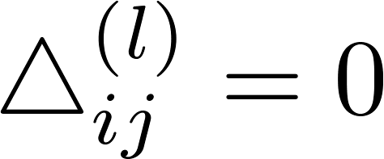


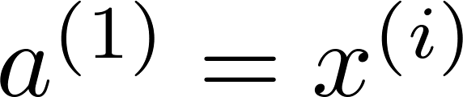

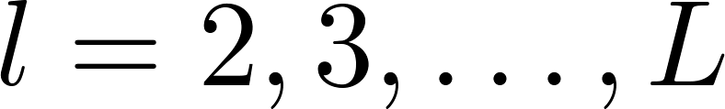

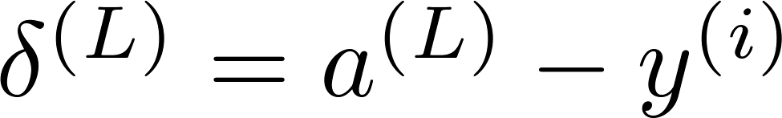
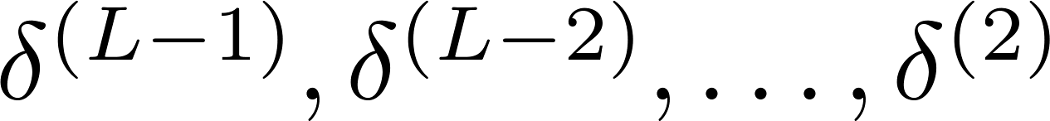
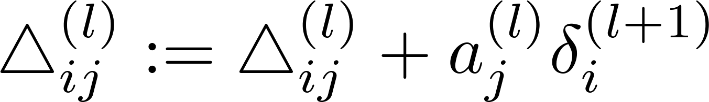
Backpropagation algorithm
Training set
Set (for all ).
For
  Set
  Perform forward propagation to compute for
  Using , compute
  Compute

Slide 33

Backpropagation algorithm
Training set
Set (for all ).
For
  Set
  Perform forward propagation to compute for
  Using , compute
  Compute
$$Δ^{(l)}≔{Δ^{(l)}+δ}^{(l+1)}{[a^{(l)}]}^{T}$$

Slide 34
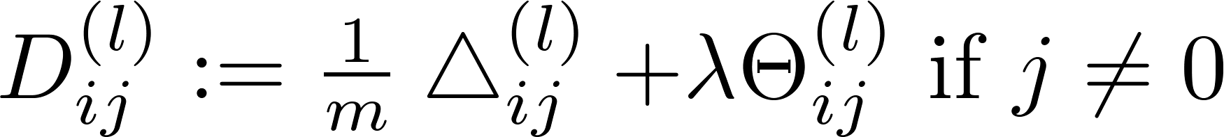
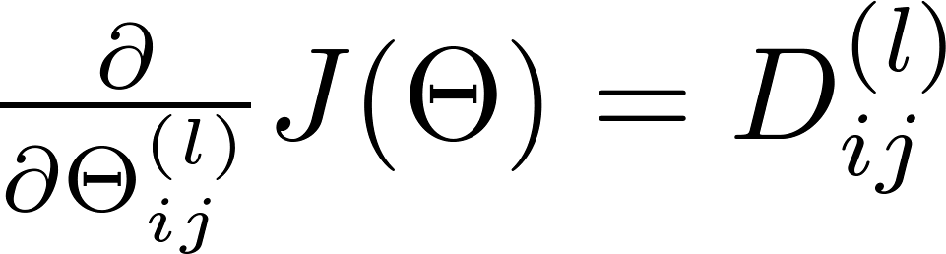
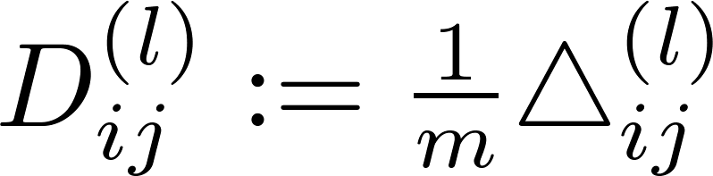

Backpropagation algorithm
Training set
Set (for all ).
For
  Set
  Perform forward propagation to compute for
  Using , compute
  Compute

Slide 35

Backpropagation intuition
Neural Networks: Learning
Machine Learning

Slide 36
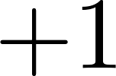


Forward Propagation

Slide 37

Forward Propagation
$$\left(x^{(i)},y^{(i)}\right)$$

Slide 38
Forward Propagation
$$\left(x^{(i)},y^{(i)}\right)$$

Slide 39


Forward Propagation
$$z_{1}^{(2)}$$
$$z_{2}^{(2)}$$
$$\left(x^{(i)},y^{(i)}\right)$$

Slide 40


Forward Propagation
$$z_{1}^{(2)}$$
$$z_{2}^{(2)}$$
$$\left(x^{(i)},y^{(i)}\right)$$

Slide 41


Forward Propagation
$$z_{1}^{(2)}$$
$$a_{1}^{(2)}$$
$$z_{2}^{(2)}$$
$$a_{2}^{(2)}$$
$$\left(x^{(i)},y^{(i)}\right)$$

Slide 42






Forward Propagation
$$z_{1}^{(2)}$$
$$a_{1}^{(2)}$$
$$z_{1}^{(3)}$$
$$a_{1}^{(3)}$$
$$z_{1}^{(4)}$$
$$a_{1}^{(4)}$$
$$z_{2}^{(2)}$$
$$a_{2}^{(2)}$$
$$z_{2}^{(3)}$$
$$a_{2}^{(3)}$$
$$\left(x^{(i)},y^{(i)}\right)$$

Slide 43
Forward Propagation
$$z_{1}^{(2)}$$
$$a_{1}^{(2)}$$
$$z_{1}^{(3)}$$
$$a_{1}^{(3)}$$
$$z_{1}^{(4)}$$
$$a_{1}^{(4)}$$
$$z_{2}^{(2)}$$
$$a_{2}^{(2)}$$
$$z_{2}^{(3)}$$
$$a_{2}^{(3)}$$
$$\left(x^{(i)},y^{(i)}\right)$$

Slide 44



Forward Propagation
$$Θ_{10}^{(2)}$$
$$Θ_{11}^{(2)}$$
$$z_{1}^{(2)}$$
$$a_{1}^{(2)}$$
$$z_{1}^{(3)}$$
$$a_{1}^{(3)}$$
$$z_{1}^{(4)}$$
$$a_{1}^{(4)}$$
$$Θ_{12}^{(2)}$$
$$z_{2}^{(2)}$$
$$a_{2}^{(2)}$$
$$z_{2}^{(3)}$$
$$a_{2}^{(3)}$$
$$\left(x^{(i)},y^{(i)}\right)$$

Slide 45
Forward Propagation
$$Θ_{10}^{(2)}$$
$$Θ_{11}^{(2)}$$
$$z_{1}^{(2)}$$
$$a_{1}^{(2)}$$
$$z_{1}^{(3)}$$
$$a_{1}^{(3)}$$
$$z_{1}^{(4)}$$
$$a_{1}^{(4)}$$
$$Θ_{12}^{(2)}$$
$$z_{2}^{(2)}$$
$$a_{2}^{(2)}$$
$$z_{2}^{(3)}$$
$$a_{2}^{(3)}$$
$$\left(x^{(i)},y^{(i)}\right)$$
$z_{1}^{(3)}=$ $Θ_{10}^{(2)}×1 +Θ_{11}^{(2)}$ $a_{1}^{(2)}+Θ_{12}^{(2)}a_{2}^{(2)}$

Slide 46
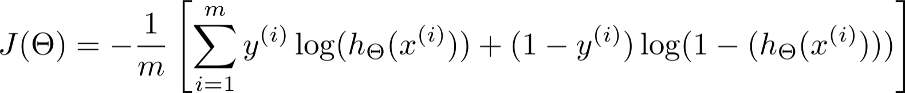


What is backpropagation doing?
Focusing on a single example , , the case of 1 output unit, and ignoring regularization ( ),
(Think of )
I.e. how well is the network doing on example i?

Slide 47


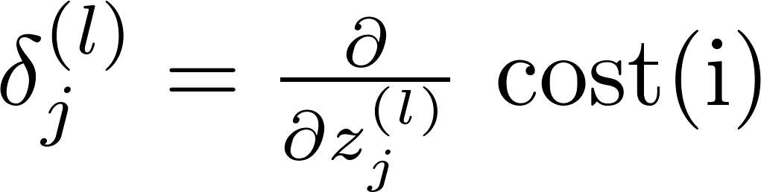












Forward Propagation
$$z_{1}^{(2)}$$
$$a_{1}^{(2)}$$
$$z_{1}^{(3)}$$
$$a_{1}^{(3)}$$
$$z_{1}^{(4)}$$
$$a_{1}^{(4)}$$
$$δ_{1}^{(4)}$$
$$z_{2}^{(2)}$$
$$a_{2}^{(2)}$$
$$z_{2}^{(3)}$$
$$a_{2}^{(3)}$$
  “error” of cost for (unit in layer ).
Formally, (for ), where

Slide 48


Forward Propagation
$$z_{1}^{(2)}$$
$$a_{1}^{(2)}$$
$$z_{1}^{(3)}$$
$$a_{1}^{(3)}$$
$$z_{1}^{(4)}$$
$$a_{1}^{(4)}$$
$$δ_{1}^{(3)}$$
$$δ_{1}^{(4)}$$
$$z_{2}^{(2)}$$
$$a_{2}^{(2)}$$
$$z_{2}^{(3)}$$
$$a_{2}^{(3)}$$
$$δ_{2}^{(3)}$$
  “error” of cost for (unit in layer ).
Formally, (for ), where

Slide 49


Forward Propagation
$$z_{1}^{(2)}$$
$$a_{1}^{(2)}$$
$$z_{1}^{(3)}$$
$$a_{1}^{(3)}$$
$$z_{1}^{(4)}$$
$$a_{1}^{(4)}$$
$$δ_{1}^{(2)}$$
$$δ_{1}^{(3)}$$
$$δ_{1}^{(4)}$$
$$z_{2}^{(2)}$$
$$a_{2}^{(2)}$$
$$z_{2}^{(3)}$$
$$a_{2}^{(3)}$$
$$δ_{2}^{(2)}$$
$$δ_{2}^{(3)}$$
  “error” of cost for (unit in layer ).
Formally, (for ), where

Slide 50
Forward Propagation
$$z_{1}^{(2)}$$
$$a_{1}^{(2)}$$
$$z_{1}^{(3)}$$
$$a_{1}^{(3)}$$
$$z_{1}^{(4)}$$
$$a_{1}^{(4)}$$
$$δ_{1}^{(2)}$$
$$δ_{1}^{(3)}$$
$$δ_{1}^{(4)}$$
$$z_{2}^{(2)}$$
$$a_{2}^{(2)}$$
$$z_{2}^{(3)}$$
$$a_{2}^{(3)}$$
$$δ_{2}^{(2)}$$
$$δ_{2}^{(3)}$$
  “error” of cost for (unit in layer ).
Formally, (for ), where

Slide 51



Forward Propagation
$$δ_{2}^{(2)}=$$
$$z_{1}^{(2)}$$
$$a_{1}^{(2)}$$
$$z_{1}^{(3)}$$
$$a_{1}^{(3)}$$
$$z_{1}^{(4)}$$
$$a_{1}^{(4)}$$
$$δ_{1}^{(2)}$$
$$δ_{1}^{(3)}$$
$$δ_{1}^{(4)}$$
$$Θ_{12}^{(2)}$$
$$z_{2}^{(2)}$$
$$a_{2}^{(2)}$$
$$z_{2}^{(3)}$$
$$a_{2}^{(3)}$$
$$δ_{2}^{(2)}$$
$$Θ_{22}^{(2)}$$
$$δ_{2}^{(3)}$$
  “error” of cost for (unit in layer ).
Formally, (for ), where

Slide 52




Forward Propagation
$$δ_{2}^{(2)}=$$
$$Θ_{12}^{(2)}$$
$δ_{1}^{(3)}$+
$$Θ_{22}^{(2)}$$
$$δ_{2}^{(3)}$$
$$z_{1}^{(2)}$$
$$a_{1}^{(2)}$$
$$z_{1}^{(3)}$$
$$a_{1}^{(3)}$$
$$z_{1}^{(4)}$$
$$a_{1}^{(4)}$$
$$δ_{1}^{(2)}$$
$$δ_{1}^{(3)}$$
$$δ_{1}^{(4)}$$
$$Θ_{12}^{(2)}$$
$$z_{2}^{(2)}$$
$$a_{2}^{(2)}$$
$$z_{2}^{(3)}$$
$$a_{2}^{(3)}$$
$$δ_{2}^{(2)}$$
$$Θ_{22}^{(2)}$$
$$δ_{2}^{(3)}$$
  “error” of cost for (unit in layer ).
Formally, (for ), where

Slide 53
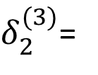


Forward Propagation
$$δ_{2}^{(2)}=$$
$$Θ_{12}^{(2)}$$
$δ_{1}^{(3)}$+
$$Θ_{22}^{(2)}$$
$$δ_{2}^{(3)}$$
$$z_{1}^{(2)}$$
$$a_{1}^{(2)}$$
$$z_{1}^{(3)}$$
$$a_{1}^{(3)}$$
$$z_{1}^{(4)}$$
$$a_{1}^{(4)}$$
$$δ_{1}^{(2)}$$
$$δ_{1}^{(3)}$$
$$δ_{1}^{(4)}$$
$$z_{2}^{(2)}$$
$$a_{2}^{(2)}$$
$$z_{2}^{(3)}$$
$$a_{2}^{(3)}$$
$$δ_{2}^{(2)}$$
$$δ_{2}^{(3)}$$
$δ_{2}^{(3)}$=
$$Θ_{12}^{(3)}$$
$$δ_{1}^{(4)}$$
  “error” of cost for (unit in layer ).
Formally, (for ), where

Slide 54
Forward Propagation

Slide 55





Forward Propagation
  “error” of cost for (unit in layer ).
Formally, (for ), where

Slide 56
Random initialization
Neural Networks: Learning
Machine Learning

Slide 57

Initial value of
For gradient descent and advanced optimization method, need initial value for .
optTheta = fminunc(@costFunction, initialTheta, options)
Consider gradient descent
Set ?
initialTheta = zeros(n,1)

Slide 58
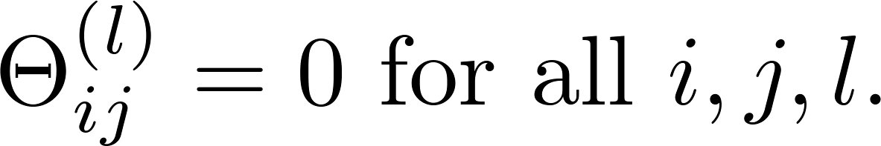




Zero initialization
After each update, parameters corresponding to inputs going into each of two hidden units are identical.

Slide 59
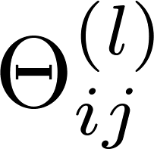
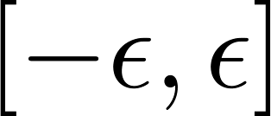
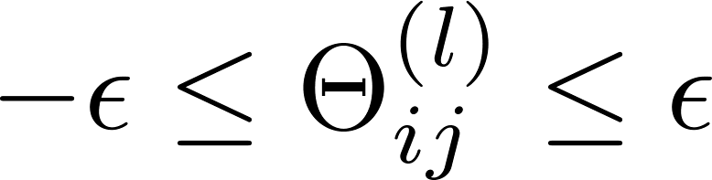
Random initialization: Symmetry breaking
Initialize each to a random value in
(i.e. )
E.g.
Theta1 = rand(10,11)*(2*INIT_EPSILON)
- INIT_EPSILON;
Theta2 = rand(1,11)*(2*INIT_EPSILON) - INIT_EPSILON;

Slide 60
Putting it together
Neural Networks: Learning
Machine Learning

Slide 61
Training a neural network
Pick a network architecture (connectivity pattern between neurons)
No. of input units: Dimension of features
No. output units: Number of classes
Reasonable default: 1 hidden layer, or if >1 hidden layer, have same no. of hidden units in every layer (usually the more the better)

Slide 62
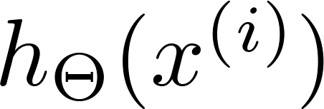

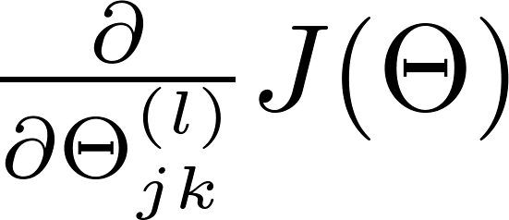
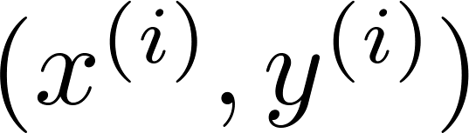

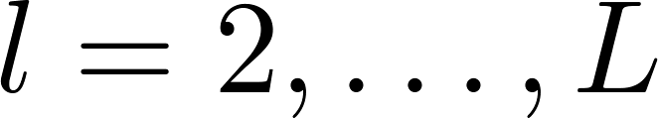
Training a neural network
Randomly initialize weights
Implement forward propagation to get for any
Implement code to compute cost function
Implement backprop to compute partial derivatives
for i = 1:m
  Perform forward propagation and backpropagation using example
  (Get activations and delta terms for ).

Slide 63

Training a neural network
Use gradient checking to compare computed using backpropagation vs. using numerical estimate of gradient of .
Then disable gradient checking code.
Use gradient descent or advanced optimization method with backpropagation to try to minimize as a function of parameters

Slide 64
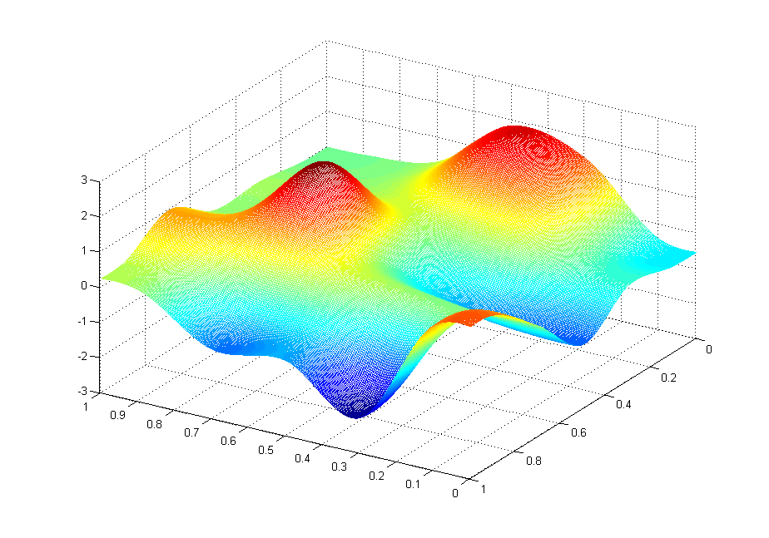



Slide 65
Backpropagation example: Autonomous driving (optional)
Neural Networks: Learning
Machine Learning

Slide 66
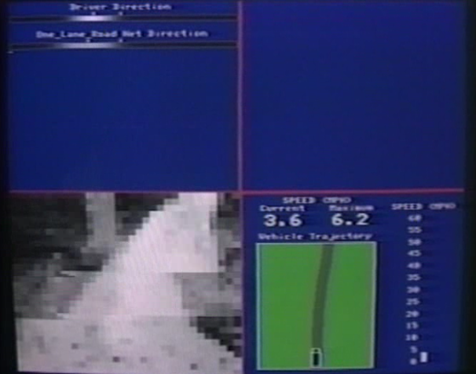
[Courtesy of Dean Pomerleau]

